Slide 1
GAMES
ARE POWERFUL CATALYST TO LEARN

Slide 2
PERSONALIZED LEARNING
Health and fun way to learn!

Slide 3
Inclusivity
AI tries different learning methods to improve the learning experience

Slide 4
Ethical using of technology
AI itself doesn’t hold copyright

Slide 5
Privacy and Security
We are not sharing any user’s data with 3rd parties

Slide 6
It is an online game to learn
Cognitive Arcadia

Slide 7
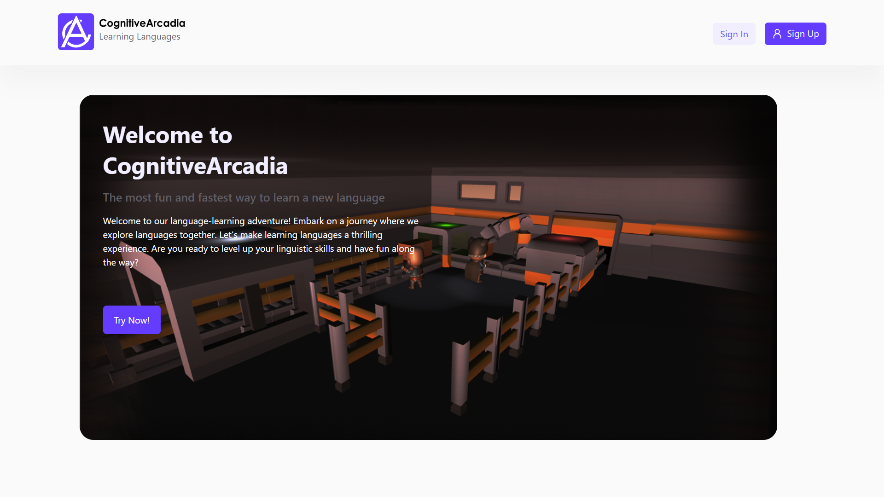

Slide 8
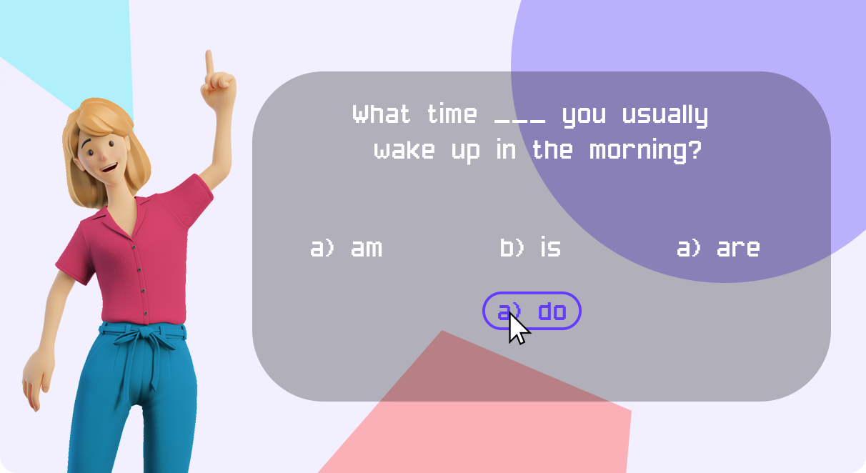

Slide 9
Let’s see the best way to learn

Slide 10
6.16M $

Slide 11
Social Media is the best way for promotion
Advertisement

Slide 12



OUR TEAM
ILAHA
SALEH
Team Leader / Designer
Full-Stack Developer
D.ÇAĞRI
Full-Stack Developer

Slide 13
THANKS!

